Slide 1

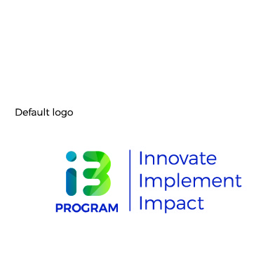

HCD Exercise

Slide 2
We’ll experience human centered design through a simple exercise.
Organise yourself as pairs.
Notes:
that move from scoping of a problem or opportunity, deep contextual understanding of people’s lives and ecosystems, synthesis of insights, generation of ideas, and finally the creation and testing of concepts with target audiences.

Slide 3
CHALLENGE
Re-design the experience of taking a loan.
TIME
60 mins
Notes:
that move from scoping of a problem or opportunity, deep contextual understanding of people’s lives and ecosystems, synthesis of insights, generation of ideas, and finally the creation and testing of concepts with target audiences.

Slide 4
THE 5 STAGES
HCD in its most basic framing is understood to have five core phases
FOUNDATION
DISCOVERY
DEFINE
IDEATION
PROTOTYPING
Build initial understanding of a problem or opportunity and the people who are impacted by or influence it
Study a problem or opportunity through the lenses of need, behaviour, motivation, pain and system dynamics - through interactions with people and other entities
Make sense of research and recognise actionable patterns, learnings, and insights to tackle problem or opportunity
Generate multiple creative ideas to solve for problem or opportunity - based on insights and understanding of users
Build and test experienceable early versions of the solution with target users
Notes:
that move from scoping of a problem or opportunity, deep contextual understanding of people’s lives and ecosystems, synthesis of insights, generation of ideas, and finally the creation and testing of concepts with target audiences.

Slide 5
DISCOVERY
Study a problem or opportunity through the lenses of need, behaviour, motivation, pain and system dynamics - through interactions with people and other entities
Listen and understand another person’s joy and pain without bias and judgment.
TIME
10 mins
TOOL
The power of stories
Notes:
that move from scoping of a problem or opportunity, deep contextual understanding of people’s lives and ecosystems, synthesis of insights, generation of ideas, and finally the creation and testing of concepts with target audiences.

Slide 6
DISCOVERY
Study a problem or opportunity through the lenses of need, behaviour, motivation, pain and system dynamics - through interactions with people and other entities
Stories are accounts of experiences rather than just generalised statements of what people like or don’t like.
Stories are rich and textured because they have emotions, actors and situations.
They are the raw data for design.
Notes:
that move from scoping of a problem or opportunity, deep contextual understanding of people’s lives and ecosystems, synthesis of insights, generation of ideas, and finally the creation and testing of concepts with target audiences.

Slide 7
Each of you to share a story that describes loan taking experience - positive or negative with your partner. Highlight emotions you may have felt.
It could be your own story or something that you have heard. Keep a note of your partner’s story. Take 5 Minutes each.
Notes:
that move from scoping of a problem or opportunity, deep contextual understanding of people’s lives and ecosystems, synthesis of insights, generation of ideas, and finally the creation and testing of concepts with target audiences.

Slide 8
DEFINE
Make sense of research and recognise actionable patterns, learnings, and insights to tackle problem or opportunity.
Uncovering the reasons behind observed emotions
TIME
10 mins
TOOL
5 Whys
Notes:
that move from scoping of a problem or opportunity, deep contextual understanding of people’s lives and ecosystems, synthesis of insights, generation of ideas, and finally the creation and testing of concepts with target audiences.

Slide 9
DEFINE
Make sense of research and recognise actionable patterns, learnings, and insights to tackle problem or opportunity.
If stories are about emotions, insights are about the underlying reasons. It’s like the tip of the iceberg - what’s hidden and outside the frame is where the insight usually lies.
Pain point (observation)
What the user was trying to accomplish (needs)
Underlying reason (insights)
Notes:
that move from scoping of a problem or opportunity, deep contextual understanding of people’s lives and ecosystems, synthesis of insights, generation of ideas, and finally the creation and testing of concepts with target audiences.

Slide 10
Reflect on the story. Ask yourself why was it a positive or negative experience? Keep asking till you feel you have gotten to the root and a strong insight.
Ask your partner any follow up questions you may have - but you do not need to confirm the insight just yet. Take 10 Min.
Notes:
that move from scoping of a problem or opportunity, deep contextual understanding of people’s lives and ecosystems, synthesis of insights, generation of ideas, and finally the creation and testing of concepts with target audiences.

Slide 11
IDEATION
Generate multiple creative ideas to solve for problem or opportunity - based on insights and understanding of users
Making the creative leap into solutions that will help the user accomplish their goals while addressing their deeper anxieties.
TIME
10 mins
TOOL
How might we… | What if…
Notes:
that move from scoping of a problem or opportunity, deep contextual understanding of people’s lives and ecosystems, synthesis of insights, generation of ideas, and finally the creation and testing of concepts with target audiences.

Slide 12
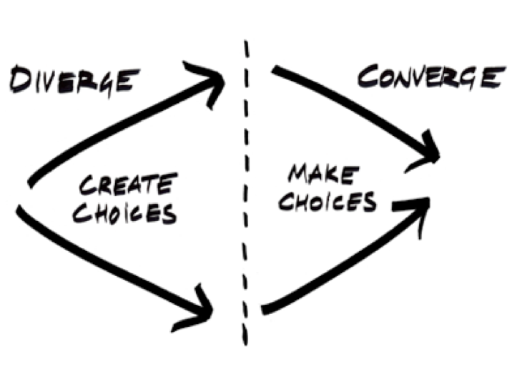
IDEATION
Generate multiple creative ideas to solve for problem or opportunity - based on insights and understanding of users
The creative process goes through a cycle of divergent and convergent thinking
Notes:
that move from scoping of a problem or opportunity, deep contextual understanding of people’s lives and ecosystems, synthesis of insights, generation of ideas, and finally the creation and testing of concepts with target audiences.

Slide 13
IDEATION
Generate multiple creative ideas to solve for problem or opportunity - based on insights and understanding of users
How might we…
This will help you frame your insight as an opportunity
What if…
… it was an object or a thing
… it was a person
… it was a service
… it was an interaction
… it was a communication
Notes:
that move from scoping of a problem or opportunity, deep contextual understanding of people’s lives and ecosystems, synthesis of insights, generation of ideas, and finally the creation and testing of concepts with target audiences.

Slide 14
Frame a HMW based on your insight and the root problem you think your partner faced. Next, use the What If tool to come up with some potential solutions.
You do not need to brainstorm with your partner but you could if both of you want to do so. Take 10 Min.
Notes:
that move from scoping of a problem or opportunity, deep contextual understanding of people’s lives and ecosystems, synthesis of insights, generation of ideas, and finally the creation and testing of concepts with target audiences.

Slide 15
PROTOTYPING
Build and test experienceable early versions of the solution with target users.
Making ideas real and tangible… to others who will help you build on it
TIME
10 mins
TOOL
Rapid sketching, Physical mock-ups
Notes:
that move from scoping of a problem or opportunity, deep contextual understanding of people’s lives and ecosystems, synthesis of insights, generation of ideas, and finally the creation and testing of concepts with target audiences.

Slide 16
PROTOTYPING
Build and test experienceable early versions of the solution with target users.
WARM UP!
Draw - “Cat” | “Loan” | “Experience”
Notes:
that move from scoping of a problem or opportunity, deep contextual understanding of people’s lives and ecosystems, synthesis of insights, generation of ideas, and finally the creation and testing of concepts with target audiences.

Slide 17
Draw out the solution (s) that you have come up with for your partner.
It doesn’t need to be perfect. Take 10 Min.
Notes:
that move from scoping of a problem or opportunity, deep contextual understanding of people’s lives and ecosystems, synthesis of insights, generation of ideas, and finally the creation and testing of concepts with target audiences.

Slide 18
PROTOTYPING
Build and test experienceable early versions of the solution with target users.
Sharing your solutions with intended users (and other stakeholders) and allowing critique and suggestions.
TIME
10 mins
TOOL
User testing
Notes:
that move from scoping of a problem or opportunity, deep contextual understanding of people’s lives and ecosystems, synthesis of insights, generation of ideas, and finally the creation and testing of concepts with target audiences.

Slide 19
PROTOTYPING
Build and test experienceable early versions of the solution with target users.
Testing can and should be done with both users and internal stakeholders.
Desirability (does it solve the problem? is it easy to use?)
Feasibility (is it doable? is it practical?)
Viability (is it affordable? are resources available?
Notes:
that move from scoping of a problem or opportunity, deep contextual understanding of people’s lives and ecosystems, synthesis of insights, generation of ideas, and finally the creation and testing of concepts with target audiences.

Slide 20
Test your solution with your partner. Consider an iteration based on your partner’s feedback.
Iterations can happen over many cycles. Take 10 Min.
Notes:
that move from scoping of a problem or opportunity, deep contextual understanding of people’s lives and ecosystems, synthesis of insights, generation of ideas, and finally the creation and testing of concepts with target audiences.

